Slide 1
INTRO TO AI/ML
B!gThinkAI - Week 2

Slide 2
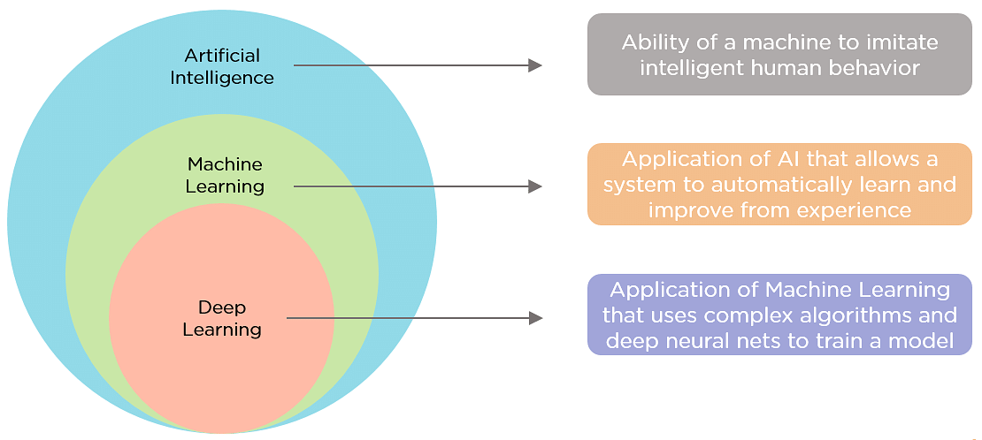

Slide 3


Types of ML Algorithms
Supervised Learning | Un-supervised Learning | Reinforced Learning
Algorithms make predictions based on a set of labeled examples that you provide You know the outcome already Ex: Rainfall in cities | Algorithm labels data classifications for you by organizing the data or describing its structure You don’t know the outcome Ex: Customer segments | Algorithms learn from outcomes and decide which action to take next After each action, the algorithm receives feedback about its correct, neutral, or incorrect decision Used for automated systems with a lot of small decisions without human guidance Ex: Robotics autonomous systems

Slide 4
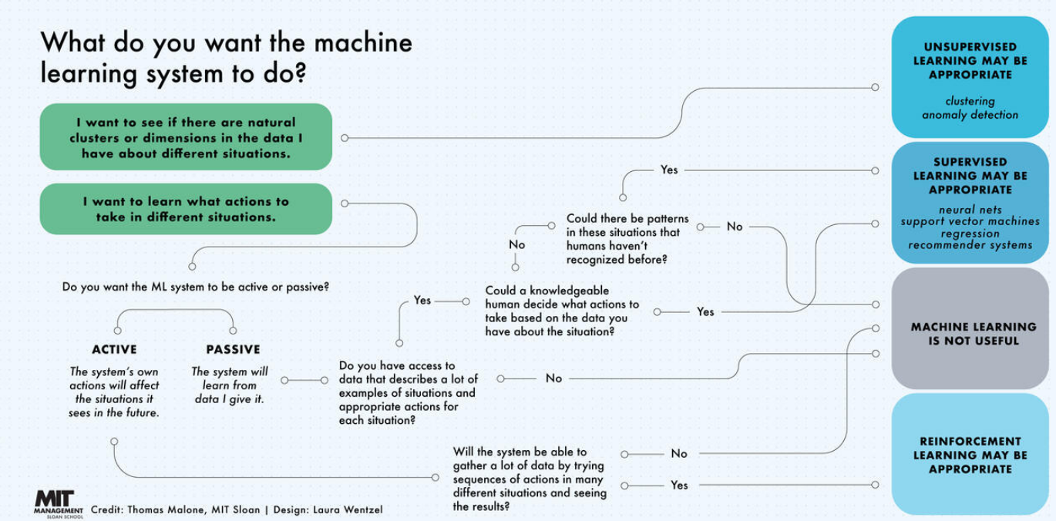

Slide 5
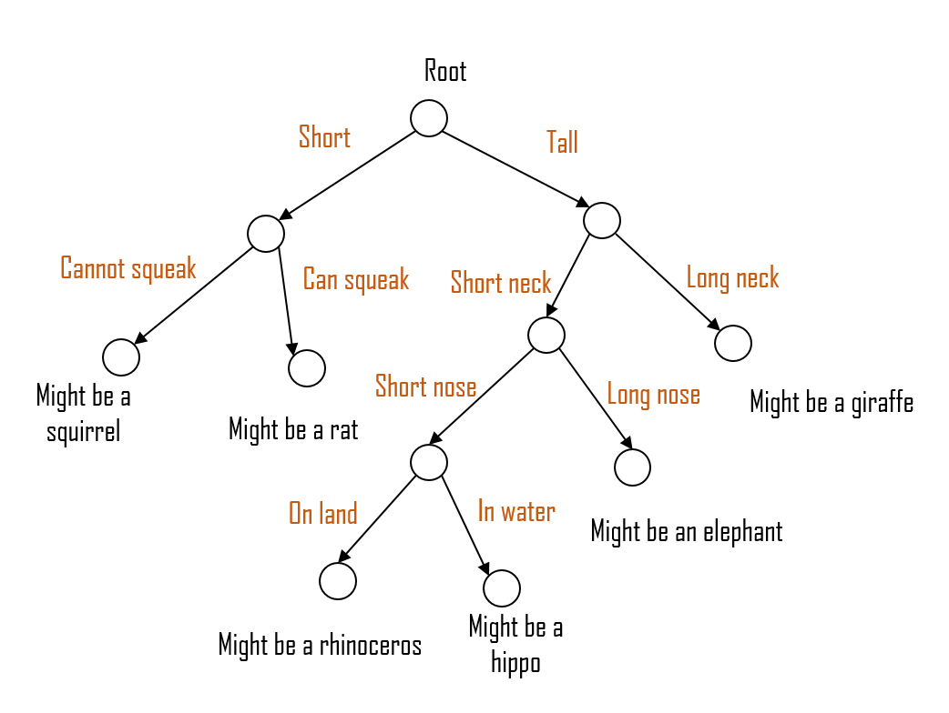
Types of ML Models
Actual stuff that you code / models that you create
Types include:
Random forest
Decision tree
Logistic/linear regression
Decision tree →

Slide 6
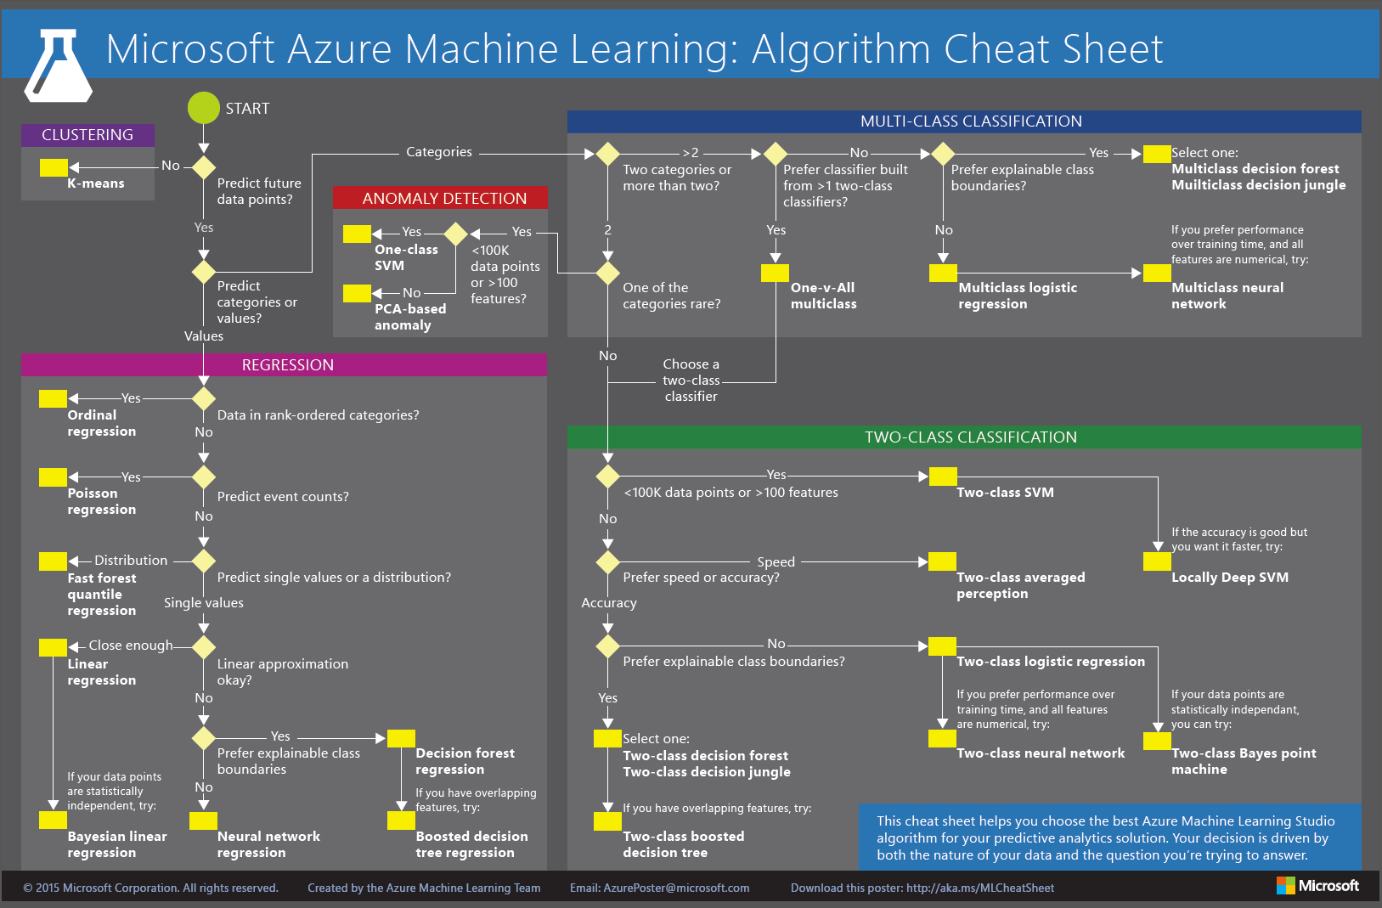

Slide 7
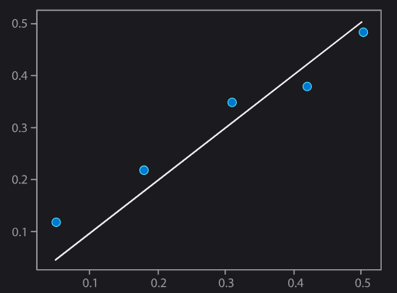
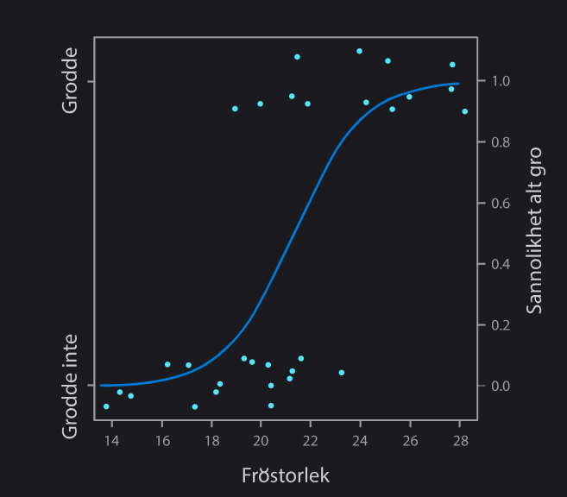
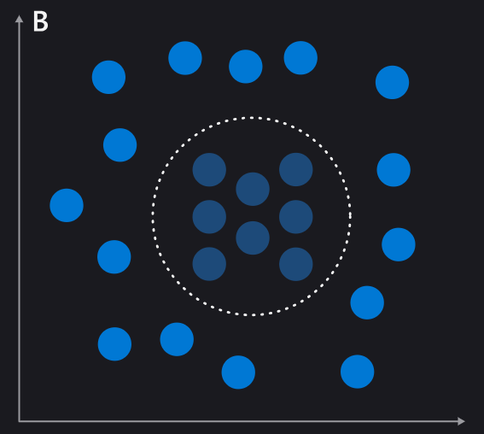
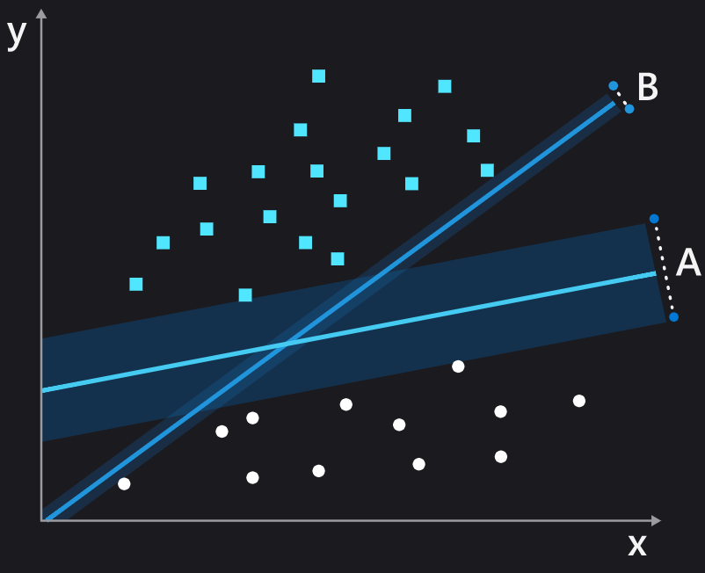
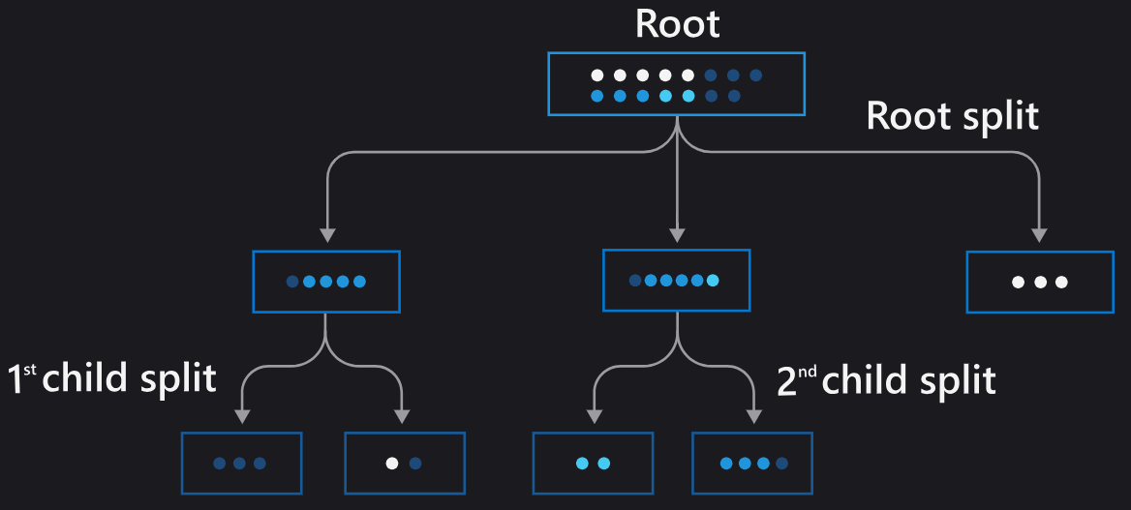
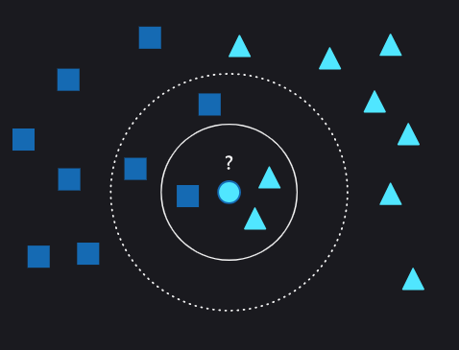
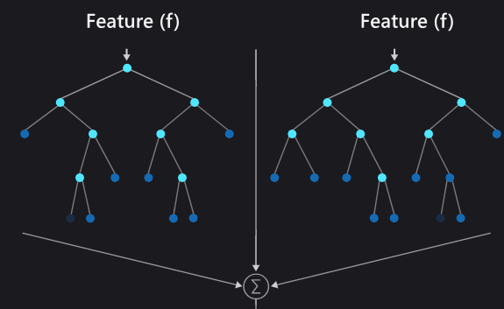
Visualizations of Models
Linear Regression
Logistic Regression
Naive Bayes
SVMs
Decision Trees
K-Nearest Neighbors
Random Forest Algorithms

Slide 8
Tools for ML
PANDAS AND NUMPY!!!!!! ← our favorites
2 libraries that help with data science and manipulation of, for example, .csv files
Automated tools that require little coding
Amazon Web Services.
Google Cloud Platform.
IBM Cloud.
Oracle Cloud Infrastructure.

Slide 9
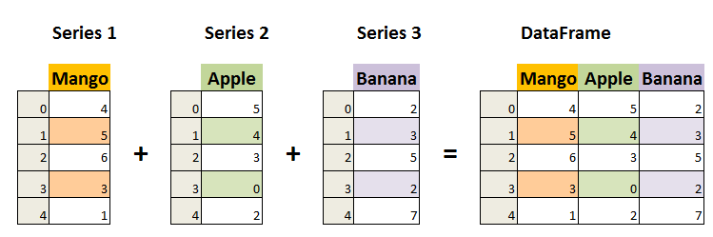
Dataframes
A Series is essentially a column for the dataframe
Is mutable
Can manipulate the data

Slide 10
Resources
https://azure.microsoft.com/en-us/resources/cloud-computing-dictionary/what-are-machine-learning-algorithms
https://www.mathworks.com/discovery/machine-learning-models.html
https://www.sas.com/en_ie/insights/articles/analytics/machine-learning-algorithms.html
https://mitsloan.mit.edu/ideas-made-to-matter/machine-learning-explained
https://www.youtube.com/watch?v=aircAruvnKk&ab_channel=3Blue1Brown

Slide 11
Colab Notebook
https://colab.research.google.com/drive/10Yi2JjnJH28dpSv-uRShvU_2ASrUbpdb?usp=sharing
MAKE A COPY OF THE NOTEBOOK SO YOU CAN EDIT IT YOURSELF!!!!

